Slide 1

HFT & Large Scale Financial System Development Cycle

Slide 2
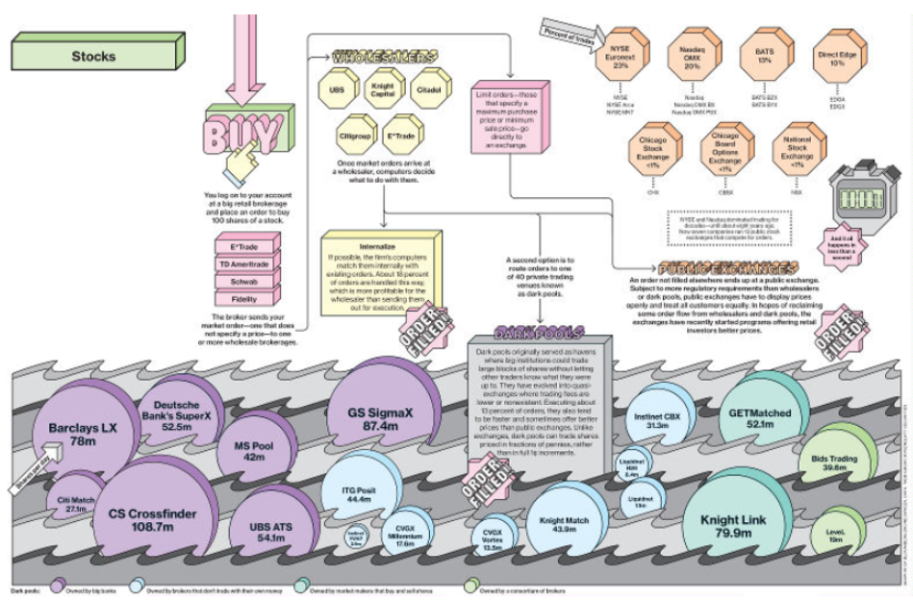
How Your Buy Order Gets Filled
Source: Bloomberg BusinessWeek

Slide 3
US Equity Trading by Market Participant
Liquidity Providers
4%
28 %
29%
Investors
3%
7%
13%
16%
Investors
Liquidity Providers
Retail
HFT Hedge Funds
Hedge Funds
HFT Broker/ Market Makers
Long Only
Independent HFT
Investment Bank Prop
Source: TABB Group Estimate

Slide 4

High Frequency Trading

Slide 5
The state of art in automated trading
High-frequency trading (HFT) broadly defines all the strategies which holding period is less than one day.
In 2009 HFT accounted for about 60% of the total traded volume around the world (and it’s growing!).
HFT is suitable for all the liquid financial instruments (exchange rates, equities, futures, options, fixed income).
Why is HFT attractive?
Relative low risk and constant steady profit.
Low correlation with long term strategies and, therefore, allowing for diversification.

Slide 6
Challenges in High-Frequency Trading
Information Technology:
Dealing with very large databases (order of Tb) for back testing.
Speed of execution
Research:
Identify a profitable strategy.
Possible Frameworks:
Regime Recognition
Event Trading
Statistical Arbitrage
Market Making
Co-location
Machine Learning

Slide 7
Ten Things that Affect the Speed of a Trading System
Programming language and efficiency of the code. C++ has been viewed as the premier language for trading system development.
Hardware specifications. Multiprocessor machines will be an advantage.
Multitasking
Data transmission speed and Network efficiency.
Third-party front-end software and API.
Clearing firm’s technology.
Operating systems. LINUX, UNIX and Microsoft Windows.
Exchange technologies.
Distance from the exchanges.
Time of day.

Slide 8
Trade System Development Cycle
As an example, Kumiega-Van Vliet Trading System Development Methodology ( K | V )
The method was jointly developed by Andrew Kumiega and Ben VanVliet.
Methodology was developed in and applied at multiple trading firms between 1995 and current
Most firms consider their development methodology to be proprietary which is the leading reason for lack of industry information

Slide 9
Key ideas in K/V software methodology
Utilize a team of Financial Engineers, Senior Programmers, Traders and Partners
Build prototypes in Excel or Matlab for speed to market
Replace excel calculations with VBA code
Replace excel interface with C/C++
Utilize a spiral design.

Slide 10
Advantages of K/V development
Rapidly develop prototype working system
Easy for multiple groups to review calculations, functionality, and GUI
Provided clear specifications for programmers to build a final application in C++
Provided test cases for the programmers implementing the system in C++
Provide a potential revenue stream utilizing Excel that can be used to fund the final development.

Slide 11
Measures of Software Complexity
lines of code
number of classes
number of modules
module interconnections and dependencies
time to understand
# of authors
… many more

Slide 12
Andriod Operating System
The Android operating system consists of 12 million lines of code, forum.xda-developers.com/wiki/Android
3 million lines of XML,
2.8 million lines of C,
2.1 million lines of Java
1.75 million lines of C++.
50 lines/page ⇒ 240,000 pages
5 words/LoC @ 50 wpm ⇒1.2M min ≈ 3 years.
Just to type!
No breaks and no thinking allowed!

Slide 13
Addressing software complexity
Requirements
Design
Implementation
Testing plan
…

Slide 14
The software lifecycle
Software lifecycle: series of steps / phases, through which software is produced
from conception to end-of-life
can take months or years to complete
Goals of each phase:
mark out a clear set of steps to perform
produce a tangible item
allow for review of work
specify actions to perform in the next phase

Slide 15
Lifecycle Stages
Virtually all lifecycles share these steps/stages/phases:
Requirements
Design
Implementation
Testing
Maintenance
Key question: how do you combine them, and in what order?

Slide 16
Software development lifecycle
– “Code-and-fix”
– Waterfall
– Spiral
– Evolutionary prototyping
– Staged delivery
– Agile (eXtreme Programming(XP), scrum, Agile 3)
… many others

Slide 17
code-and-fix: write some code, debug it, repeat (i.e., ad-hoc)
waterfall: standard phases (req., design, code, test) in order
spiral: assess risks at each step; do most critical action first
evolutionary prototyping: build an initial small requirement spec, code it, then "evolve" the spec and code as needed
staged delivery: build initial requirement specs for several releases, then design-and-code each in sequence

Slide 18
Code-and-fix model
Advantages
Little or no overhead
– just dive in and develop, and see progress quickly
Applicable sometimes for very small projects and short-lived prototypes
But DANGEROUS for most projects
No way to assess progress, quality or risks
Unlikely to accommodate changes without a major design overhaul
Unclear delivery features (scope), timing, and support

Slide 19
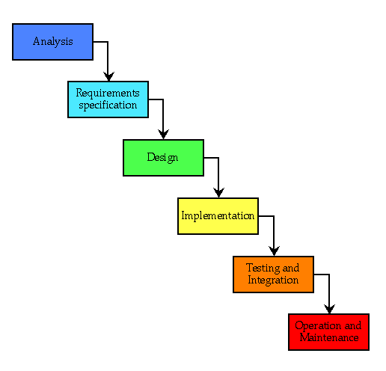
Waterfall model

Slide 20
Waterfall model advantages
Can work well for projects that are very well understood but complex
Tackles all planning upfront
The ideal of no midstream changes equates to an efficient software development process
Supports inexperienced teams
Orderly, easy-to-follow sequential model
Reviews at each stage determine if the product is ready to advance

Slide 21
Waterfall model limitations
Difficult to specify all reqs of a stage completely and correctly upfront
requires a lot of planning up front (not always easy)
assumes requirements will be clear and well-understood
Rigid, linear; not adaptable to change in the product
costly to "swim upstream" back to a previous phase
No sense of progress until the very end
nothing to show until almost done ("we're 90% done, I swear!")
Integration occurs at the very end
Defies “integrate early and often” rule
Solutions are inflexible, no feedback until end
Delivered product may not match customer needs
Phase reviews are massive affairs
Inertia means change is costly

Slide 22
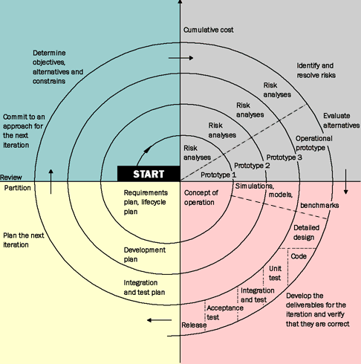
Spiral model – risk oriented
Determine objectives and constraints
Identify and resolve risks
Evaluate options to resolve risks
Develop and verify deliverables
Plan next spiral
Commit (or not) to next spiral

Slide 23
Spiral model
Oriented towards phased reduction of risk
Take on the big risks early, make decisions
are we building the right product?
do we have any customers for this product?
is it possible to implement the product with the technology that exists today? tomorrow?
Progresses carefully to a result
tasks can be more clear each spiral

Slide 24
Spiral model
Advantages
Especially appropriate at the beginning of the project, when the requirements are still fluid
Provides early indication of unforeseen problems
Accommodates change
As costs increase, risks decrease!
– Always addresses the biggest risk first

Slide 25
Spiral model disadvantages
A lot of planning and management
Frequent changes of task
But, get to stick with one product feature/goal
Requires customer and contract flexibility
Developers must be able to assess risk
Must address most important issues

Slide 26
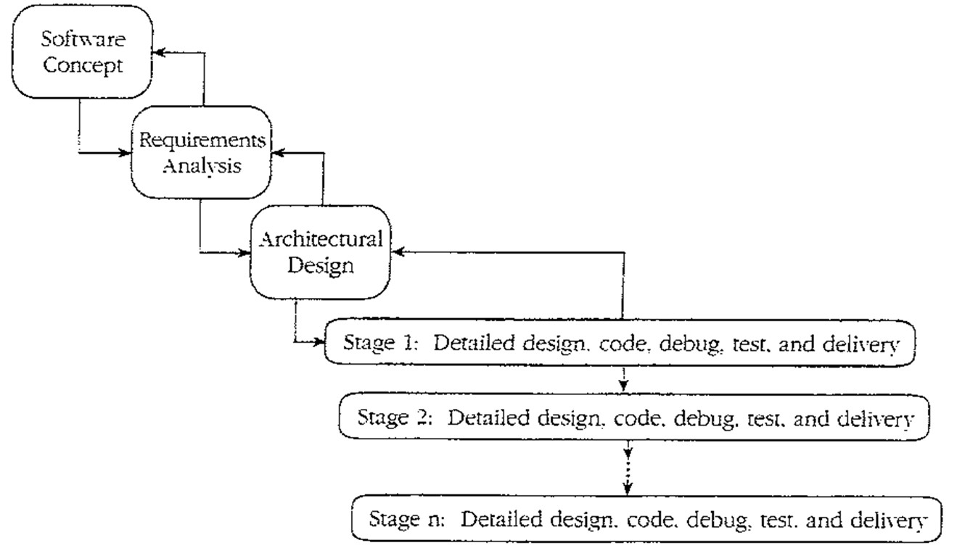
Staged delivery model
Waterfall-like beginnings, then short release cycles: plan, design, execute, test, release with delivery possible at the end of any cycle.

Slide 27
Staged delivery model advantages
Can ship at the end of any release cycle
– Looks like success to customers, even if not original goal
Intermediate deliveries show progress, satisfy customers, and lead to feedback
Problems are visible early (e.g., integration)
Facilitates shorter, more predictable release cycles
Very practical, widely used and successful

Slide 28
Staged delivery model disadvantages
Requires tight coordination with documentation, management, marketing
Product must be decomposable
Extra releases cause overhead

Slide 29
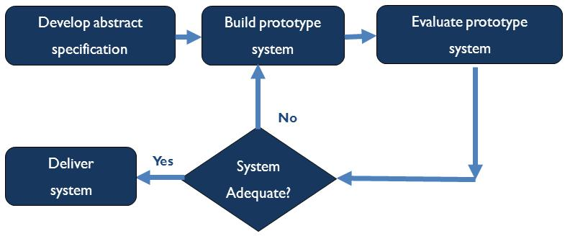

Evolutionary prototyping model
Develop a skeleton system and evolve it for delivery

Slide 30
Evolutionary prototyping model
Another popular and successful model, especially for custom products
Staged delivery ≠ evolutionary prototyping
Staged delivery: requirements are known ahead of time
Evolutionary: discovered by customer feedback on each release
Advantages
Addresses risks early
Produces steady signs of progress, builds customer confidence
Useful when requirements are unknown or changing
Customer involvement ("What do you think of this version?")

Slide 31
Evolutionary prototyping limitations
Requires close customer involvement
Assumes user's initial spec is flexible
Problems with planning
Especially if the developers are inexperienced
Feature creep, major design decisions, use of time, etc.
Hard to estimate completion schedule or feature set
Unclear how many iterations will be needed to finish
Integration problems
fails to separate pieces that must then be integrated
bridging; new software trying to gradually replace old
Temporary fixes become permanent constraints

Slide 32
Overview of the Kumiega-Van Vliet Trading System Development Methodology
Hybrid solution that combines multiple software frameworks that has been tuned for trading system development using a modeling language and an object orientated language
Waterfall Methodology
Spiral Methodology
Stage-Gate™ Methodology
Go. Go on to the next stage of the waterfall.
Hold. Hold development at the current stage for reconsideration at a future date or continuing usage as a proto-type
Return. Return to a previous stage for additional research or testing.
Kill. Kill the project entirely.
* Stage-Gate is a registered trademark of R.G. Cooper & Associates Consultants, Inc., a member company of the Product Development Institute. See www.prod-dev.com

Slide 33
Plan
Determine the problem to be solved, gather information, and then plan and document a course of action to solve it.
Benchmark
Research and compare alternative solutions to arrive at the best practice. Over the four stages of the methodology, quantitative methods, data cleaning and optimization algorithms, technology, and portfolio and risk management processes are all benchmarked.
Do
Carry out the best practice course of action.
Check
Check to see if the desired results were achieved along with what, if anything, went wrong, and document what was learned.
If results are not satisfactory, repeat the cycle using knowledge gained.

Slide 34
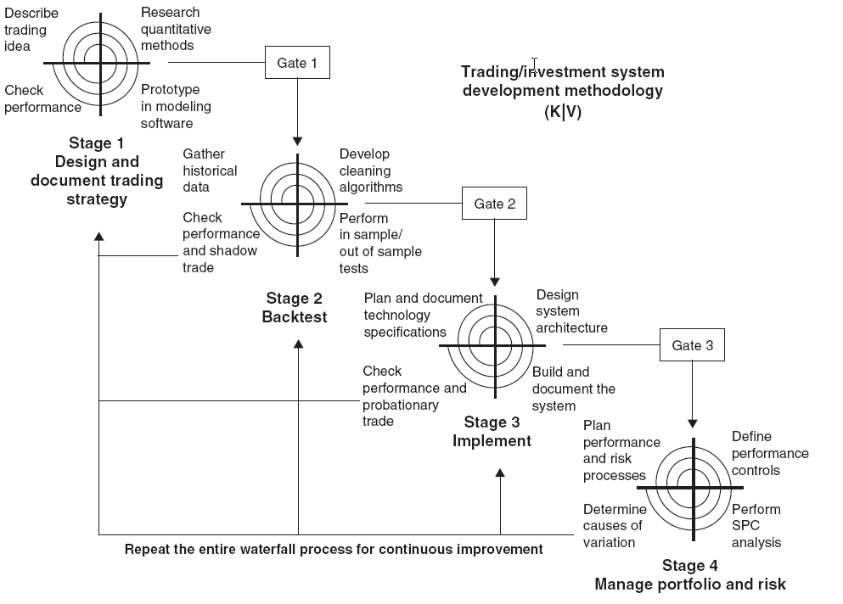

Slide 35
K/V Trading System Development Stage
Stage I. Research and Document Design
Describe idea
Fully articulate the business logic and quantitative methods
Over the iterative research process, planning each loop will require team members to re-define goals and set boundaries for that research.
Research quantifiable methods
Derive proprietary algorithms
Apply publicly available research from journals, books, the Internet, or white papers
Prototype
Quickly build several generations in order to evaluate whether a particular idea warrants further investigation and to promote risk-based iterative development
Check performance
Develop a clear plan on how to measure performance and define success and the variability of the trading system
Gate 1 Review mathematics and methodology
This gate will prevent development of the trading/investment system from moving to the back testing stage until the required activities and deliverables have been completed in a quality manner.

Slide 36
A key output of stage 1 is to identify the outputs that can be controlled
Mean/Median Profit and Loss
Average, Range and Standard Deviation of Returns
Sharpe and Sortino Ratios
Average Time in Trade
Number of Winning and Losing Trades, Winning and Losing Days
Drawdowns
Maximum Negative Excursions
Information Coefficient / Spearman Correlation

Slide 37
K/V Trading System Development Stage
Stage II. Back Test
Gather data
Build a customized database of historical data and purchase or build a software tool that allows for proper back testing of the system Required data may either not exist at all or is prohibitively expensive based upon the prospective returns of the trading/investment system
Develop data cleaning methods
Development of a Data Transformation Management System (DTMS) that will scan data for errors and irregularities is essential
Perform algorithm benchmarking with sample data
1. Profitable both in sample and out of sample.
2. Profitable in sample, but not out of sample.
3. Unprofitable both in sample and out of sample.
4. Use statistical process control to check for ambiguity in trading
algorithm output.
Check Performance and Probationary Trade
Shadow trade the algorithm
Not indicative of performance due to lack of SPC control algorithms
Mainly used to help design interfaces, risk controls and SPC controls
Gate 2 Review research results and formalize development plan

Slide 38
K/V Trading System Development Stage
Stage III. Implement
Plan and Document Technology Specifications
Fully define the functionalities and performance requirements of the trading/investment system. The specification documents allow the team of hardware engineers and programmers to quickly build the system with the correct functionalities and to the proper specifications.
Design System Architecture
Architecture documents are blueprints of the hardware and software that will form the architecture of the trading/investment system, including the financial calculations, real-time data and user interfaces, order routing connections, reporting functionalities, and any other necessary processes.
Build and Document the System
The process of construction will be a step-by-step march through the architecture documents.
Architecture documents themselves will be evolving as the team spirals through implementation utilizing the four stages of plan, do, benchmark and check.
Check Performance and Probationary Trade
Purpose of probationary trading is to allow the trader or money manager time to use the trading tools and determine what additional reporting tools need to be built to properly manage the embedded risks
Gate 3 Review development of system

Slide 39
K/V Trading System Development Stage
Stage IV. Monitor
Plan Performance and Risk Processes
Reports will present the portfolio statistics and performance metrics, risk calculations, and provide documentation of the attribution of gains and losses.
Define Performance Controls
These risk control techniques help the team understand whether or not the system is working within specifications and in conformance with the back test and/or a benchmark
Markets are stochastic and trading/investment system performance will be stochastic as well.
Perform Statistical Process Control (SPC) analysis
Are the underlying market distributions the same as the ones that were used to generate returns for the back test?
Is the system in conformance with the back test and the benchmark index?
Are the inputs or outputs of the process different?
Determine causes of variation in performance
Systems will need to be continuously tweaked utilizing a Six sigma approach
Repeat the entire waterfall process for continuous improvement.

Slide 40
References
High Frequency Trading , Larry Tabb, Tabb Group, World Federation of Exchanges, Cambridge, MA, Nov, 2009.
Large-Scale C++ Software Design, by John Lakos, Addison-Wesley Professional, 1996, ISBN-10: 0201633620
Seminar: Advanced C++ Programming,
www10.informatik.uni-erlangen.de/Teaching/Courses/SS2013/CPP/
University of Washington, CSE403 Lectures Materials, courses.cs.washington.edu/courses/cse403/11sp/lectures/
A Methodology for Trading and Investment System Development, Andrew Kumiega, Infinium Capital Management, www.infotech.northwestern.edu/KumiegaNorthwestern.ppt

